Slide 1
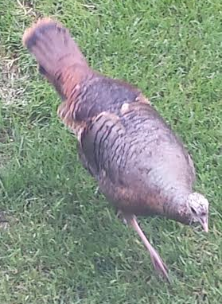
{{CompanyName}}, Director of Everything
Manager:
Tanya Jones
Experience:
7 Years
CC/Salary Grade:
CC04/SG 10
Time in Role:
6.7 Years
Likely Next Roles:
Director of More Stuff, Executive Stuff Director, Emperor
Performance/Leadership Strengths:
Employee Info:
Development Needs:
Good at Things
Likes Stuff
Excel
Surfing
Brute Strength
A1/A1/A1
Black Belt Certified
International Experience
Willing to Relocate
United States
Communication Skills
Spear Fishing Skills
Climbing Skills
Stuff
Things

